Slide 1
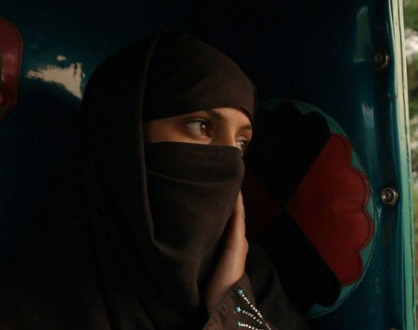
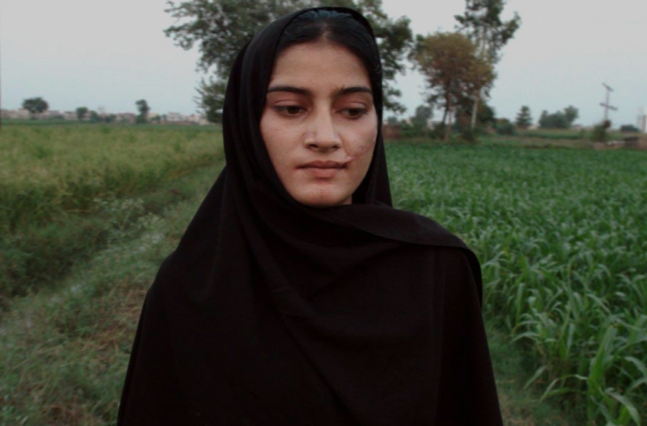

A Girl In A River : The Price Of Forgiveness

Slide 2
Presented by
Zain
Moiz
Noman
Sharjeel

Slide 3
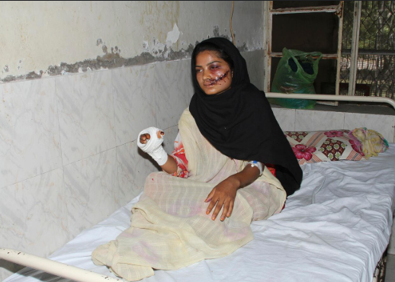
Brief Introduction
Based on a true story of Saba Maqsood (2014)
Highlights honor killing and forgiveness culture in Pakistan
What happens when justice and family loyalty collides

Slide 4
What happens when seeking justice means defying your own Blood?

Slide 5


Slide 6
Objectives
The reason for selection
Summery
Systemic problems and reforms
Conclusion and suggestions
Main message

Slide 7
Reason For Selection
Powerful, emotional survivor led narrative
Reflects thousands of untold stories
Makes us question if survival is enough when justice is denied?

Slide 8
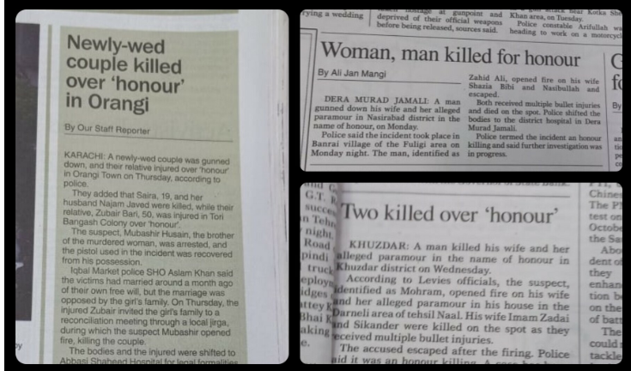
Honor Killings
Honor killing is murder to restore family honor
Bushra (2022):A teen from Faisalabad killed for having a phone
1005 women killed in Pakistan in 2022 in the name of honor according to the Human Rights Commission of Pakistan

Slide 9
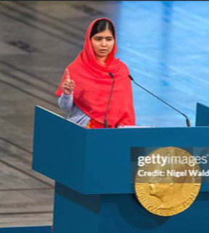
Women’s Rights
Rights to education, safety, equality often denied
Malala Yousafzai in 2012 Shot by Taliban for schooling activism
12 million girls were out of school in Pakistan UNICEF 2023
Violence is used to control women's choices

Slide 10

Forgiveness Laws
Qisas and Diyat laws allow family to forgive killers
Samia Shahid 2016 British Pakistani killed by family
When family is the perpetrator justice is impossible
Law reformed only after 2016 due to pressure

Slide 11
Main Message

Slide 12
Honor valued more than a woman's life
Saba age 18 shot by father and uncle, survived
Pressured to forgive
Exposes how law favors perpetrators over victims

Slide 13

About the Director
Sharmeen Obaid Chinoy
First Pakistani woman to win 2 Oscars
Saving Face 2012
A Girl in the River 2016
Named in Time 100 list in 2012

Slide 14
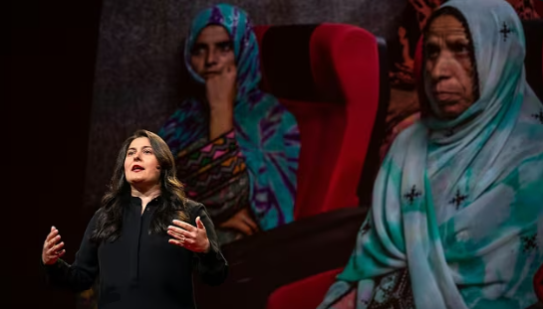
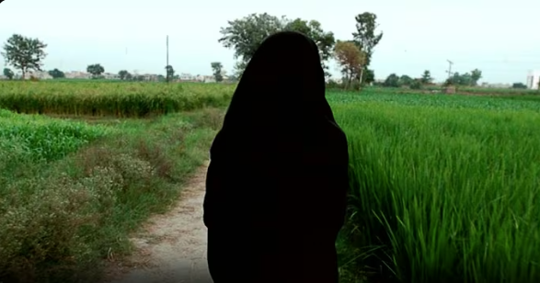
Her Filmmaking Style
Focus women, injustice, extremism
Features real survivors
Uses journalism and cinema to create impact
Aims to influence policy not just awareness

Slide 15
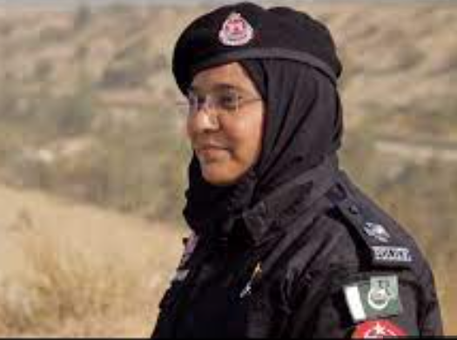
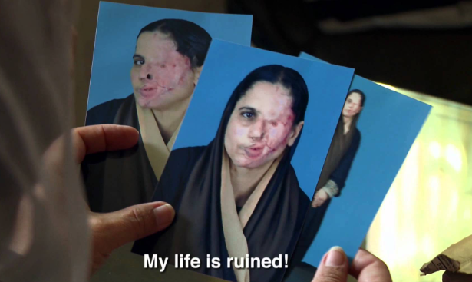
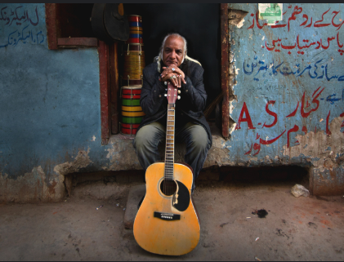
Reference to Documentaries
Saving Face 2012 :
Acid attack survivors led to Acid Control Act
Freedom Fighters 2018 : Women activists
Song of Lahore 2015:
A story of underrated singers attacked by extremists

Slide 16
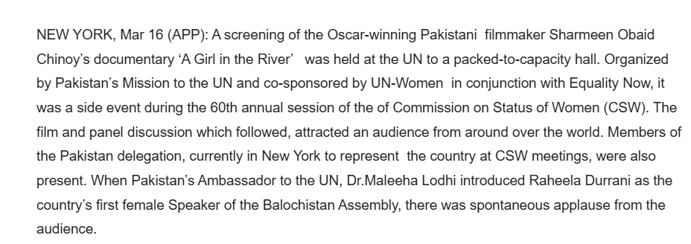
Global Awareness
Screened at United Nations
Inspired international legal debates
Became symbol for South Asian women's rights movement

Slide 17
Summary of the Documentary

Slide 18
Saba marries by choice attacked by family
Survives with bullet wounds
Faces pressure to forgive in court
Her story reflects thousands who do not survive

Slide 19

Legal Loophole
Qisas lets family forgive is used to escape justice
Saba’s case shows how law becomes negotiation
Justice becomes a private affair not a public right

Slide 20
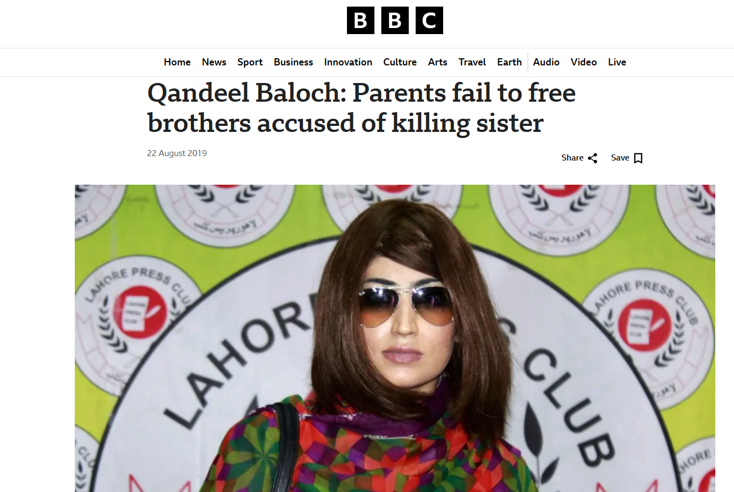
Real World Echoes
Qandeel Baloch 2016 Killed by her brother and parents tried to forgive
Samia Shahid in 2016 Killed for marrying freely
Fakhra Younus in early 2000 Acid attack, died by suicide

Slide 21
Broader Statistics
Over 1000 honor killings per year Human Rights Commission of Pakistan
88 percent forgiven by family HRCP 2015
Only 6 percent reach conviction
Rural women No legal aid, no media voice

Slide 22
Strengths and Weaknesses

Slide 23

Strengths
Real survivor’s voice
Legal critique with global impact
Influenced national law in 2016

Slide 24

Weaknesses
Focuses on one case only
No long term follow up
Minimal visuals, repetitive shots

Slide 25
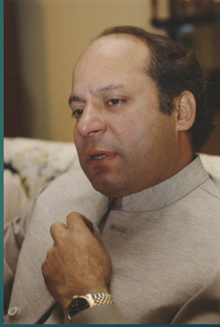
Political Impact
Oscar win February 28,2016
PM Nawaz Sharif promised law reform
October 6, 2016, Parliament passed anti honor killing law
Mandatory life sentence even with forgiveness

Slide 26
Final Reflection
Until we reform the system, no woman is safe, not in the courtroom, not in her home, and not even in the river
Saba fought not just attackers but
A flawed justice system
A silencing society
A family prioritizing shame over love

Slide 27
Any Questions?

